Slide 1
Algorithms

Slide 2






Slide 3







Slide 4
Bubble Sort
If we are sorting n numbers, then we have to do (n-1) comparisons in each pass.
And, we have to do (n-1) passes.
Therefore in total, we have to do (n-1)(n-1) comparisons in order to complete a bubble sort.

Slide 5



Slide 6









Slide 7





Slide 8



Slide 9







Slide 10
In this lecture you will learn:
What is an algorithm?
How to compare performance of algorithms
What is a data structure?
Bubble Sort
Shaker Sort
Selection Sort
Insert Sort
Shell Sort Assignment for you to investigate
Heap Sort
Quick Sort

Slide 11
Selection Sort
Treat the array as if it is not sorted. Search for the smallest number and swap it into position 0.
Move to position 1 and search the unsorted part of the array for the next smallest number and swap it into position 1.
Keep going until done.

Slide 12






Slide 13



Slide 14






Slide 15


Slide 16




Slide 17



Slide 19








Slide 20



Slide 21
Algorithm
A finite, and definite procedure for solving a problem.
The finiteness is important; an algorithm must terminate in a finite number of steps.
Definiteness is also important. At each step, an algorithm must make progress toward arriving at a solution to a problem. No guesses are made.

Slide 22
Euclid’s algorithm
algorithm hcf(n,m) // calculate hcf of positive integers n, m
begin
repeat begin
l = remainder on dividing n by m.
n = m
m = l
until m = 0 // required hcf is n.
end
The algorithm above can be shown to be finite and definite. On the other hand the problem of finding the decimal representation of √2 cannot be solved by an algortihm, so far as we know, because there are infinitely many decimal digits to be found and they cannot be described finitely because they not not repeat and do not follow a clear pattern.
The problem of finding a specified finite number of decimal digits for √2 is an algorithmic problem, however.

Slide 23
Interesting aspects
What is involved in the study of algorithms:
Finding algorithms to solve important problems
Evaluating these algorithms. Are they good or bad? Could we expect to do better by studying the problem further?
The usual measure of quality of an algorithm is its speed – does it do its job efficiently?
Space is another quality - does it require additional space?

Slide 24
Euclid’s algorithm (cont)
Considered to be a very good algorithm.
It is simple and is the quickest known way to solve the problem.
Compare it, for example, with the equally correct method which starts with the lesser or n and m and successively reduces it by 1 until it divides both n and m.
It would be a useful exercise for you to program these two methods and then compare their running times when required to find the hcf of two six digit numbers

Slide 25
Equivalent Algorithms: which is preferable and why?
public static int hcf(int n, int m) {
do {
int l = n % m;
n = m;
m = l;
} while (m != 0);
return n;
}
public static int hcfAlt(int n, int m) {
int startingPoint = n < m ? n : m;
int divisor;
for (divisor = startingPoint; divisor > 0; divisor--)
if (n % divisor == 0 && m % divisor == 0)
break;
return divisor;
}

Slide 26
Recursive algorithms
These are usually divided into one or more base cases and a recursive case. These are usually when writing code for intrinsically recursive data structures. Here are a couple of examples:
This can be coded using either of the following methods:
public static int factorialByIteration(int n) {
int prod = 1;
for (int i = n; i >= 1; i--)
prod = prod * i;
return prod;
}
public static int factorialByRecursion(int n) {
if (n == 0 || n == 1)
return 1;
else
return n * factorialByRecursion(n - 1);
}

Slide 27
Another example
The fibonacci sequence is a famous example:
This could be implemented in the following two ways:
public static int fibByRecursion(int n) {
if (n < 2)
return n;
else
return fibByRecursion(n - 1) + fibByRecursion(n - 2);
}
Invoking using this loop will produce the following output:
1 1 2 3 5 8 13 21 34
public static int fibByIteration(int n) {
int a = 1, b = 1;
for (int i = 3; i <= n; i++) {
int c = a + b;
a = b;
b = c;
}
return b;
}
for (int i = 1; i < 10; i++)
System.out.print(fibByRecursion(i)+ "\t");

Slide 28
Iterative Equivalent
Every recursive algorithm can also be written in an iterative form, but this is not necessarily an easy exercise. For the factorial function, an iterative equivalent might be:
public static int factorialByIteration(int n) {
int prod = 1;
for (int i = n; i >= 1; i--)
prod = prod * i;
return prod;
}

Slide 29
2 ways of adding up Array elements
public static int addByIteration(int[] a, int start, int end) {
int sum = 0;
for (int i = start; i <= end; i++) {
sum = sum + a[i];
}
return sum;
}
public static int addByRecursion(int[] a, int start, int end) {
if (end > start)
return a[end] + addByRecursion(a, start, end - 1);
else
return a[start];
}
These methods can be invoked as follows
public static void main(String[] args) {
int[] a = {5, 3, 2, 4, 1};
System.out.println(addByIteration(a, 0, a.length - 1));
System.out.println(addByRecursion(a, 0, a.length - 1));
}

Slide 30
Two recursive approaches
rest
end
public static int addByRecursion(int[] a, int start, int end) {
if (end > start)
return a[end] + addByRecursion(a, start, end - 1);
else
return a[start];
}
start
rest
public static int addByRecursionOtherVersion(int[] a, int start, int end) {
if (start < end)
return a[start] + addByRecursionOtherVersion(a, start + 1, end);
else
return a[end];
}

Slide 31



Slide 32



Slide 33
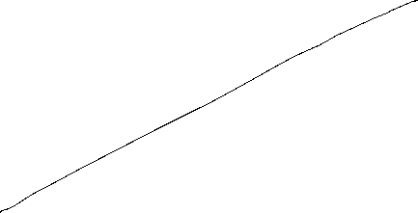

Slide 34




Slide 35






Slide 36





Slide 37



Slide 39








Slide 41
Big O notation
The Big O notation is used in Computer Science to describe the performance or complexity of an algorithm.
This notation focuses on the worst-case scenario.
It can be used to describe the execution time required or the space required -in memory or on disk- by an algorithm.
One possible way to readily explain how the Big O notation works is to provide a number of examples in code.
We focus on how the function behaves as its input grows large.
Asymptotic notation is a standard means for describing families of functions that share similar asymptotic behavior.
Asymptotic notation allows us to ignore small input sizes, constant factors, lower-order terms in polynomials, and so forth.

Slide 42
O(1)
This describes an algorithm that will always execute in the same amount of time or space, regardless of the size of the input data set.
boolean isFirstElementNull(String[] strings) {
if(strings[0] == null) {
return true;
}
return false;
}

Slide 43
O(n)
n is the input data set size.
Describes an algorithm whose execution time or space required will grow in a linear fashion and in direct proportion to the size of the input data set.
Looking at the given example illustrates how the Big O notation is used: it is possible that a matching string could be found during any iteration of the for loop and the function would return early. However, the Big O notation will always assume the upper limit. That is a situation where the algorithm will perform the maximum number of iterations.
For example, a linear search
boolean containsValue(String[] strings, String value) {
for(int i = 0; i < strings.length; i++) {
if(strings[i] == value) {
return true;
}
}
return false;
}

Slide 44
O(n²)
n is the input data set size.
Describes an algorithm whose execution time or space required is directly proportional to the square of the size of the input data set.
This is common with algorithms that involve nested iterations over the data set. More deeply nested interations will result in O(n³), O(n⁴), etc.
boolean containsDuplicates(String[] strings) {
for(int i = 0; i < strings.length; i++) {
for(int j = 0; j < strings.length; j++) {
if(i == j) // Don't compare with self {
continue;
}
if(strings[i] == strings[j]) {
return true;
}
}
}
return false;
}

Slide 45
O(2^{n})
Describes an algorithm whose execution time or space required doubles for each additional element in the input data set.
As n increases, the execution time of an O(2^{n}) function will quickly become very large.

Slide 46
O(log n)
Searching through an array is commonly used to explain algorithms of this type. A search through an unsorted array is O(n), however it is possible to search through a sorted array in a time O(log n).
This can be done as follows:
For the iterative version given below, count the number of steps required to find value.
int binarySearch(int a[], int value, int left, int right) {
while (left <= right) {
int middle = (left + right) / 2;
if (a[middle] == value)
return middle;
else if (a[middle] > value)
right = middle - 1;
else
left = middle + 1;
}
return -1;
}

Slide 47
O(log n) - A recursive implementation
int binarySearch(int[] a, int value, int left, int right) {
if (left > right)
return -1;
int middle = (left + right) / 2;
if (a [middle] == value)
return middle;
else if (a[middle] > value)
return binarySearch(a, value, left, middle - 1);
else
return binarySearch(a, value, middle + 1, right);
}

Slide 48
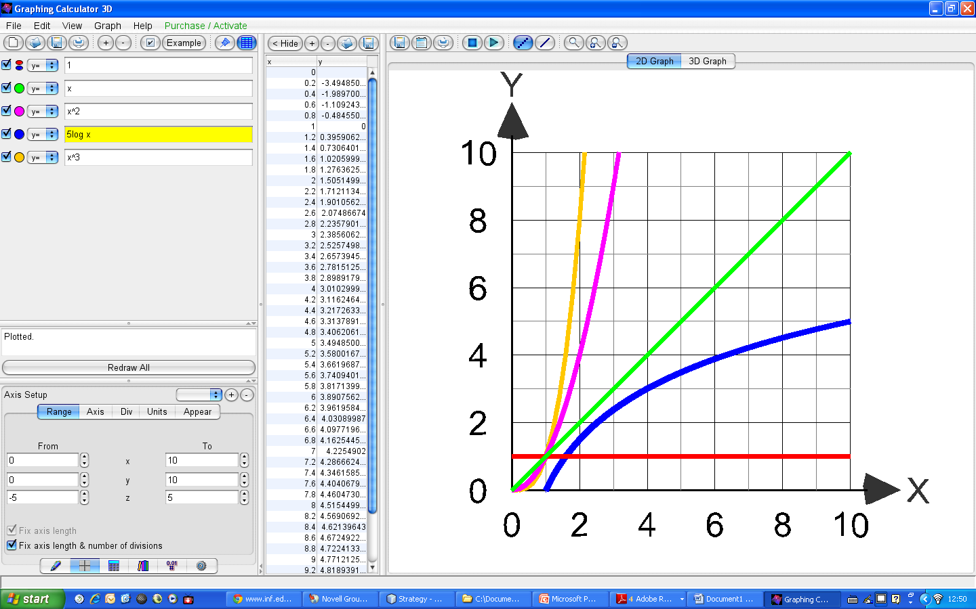
Asymptotic growth rates
Y=n³
Y=n²
Y=n
Y=5log n
Y=1
n

Slide 49
Bubble Sort
Properties:
Stable
O(1) extra space
O(n²) comparisons and swaps
Adaptive: O(n) when data is nearly sorted
public void sort(int[] a) {
for (int j = 0; j < a.length-1; j++)
for (int i = 0; i < a.length-1-j; i++)
if (a[i] > a[i+1]) {
int temp = a[i];
a[i] = a[i+1];
a[i+1] = temp;
}
}

Slide 50
Bubble Sort
The Bubble Sort can be readily improved in certain ways.
An obvious approach is to remember whether or not any exchanges have taken place during a pass. A last pass, without any exchanges is therefore necessary to determine that the algorithm may be terminated.
However, this improvement, may itself be improved by remembering not only that an exchange took place, but remembering the position (index k) of the last exchange. For example, it is clear that all pairs of adjacent items above this index k are in the desired order. Subsequent scans may therefore be terminated at this index.
There is also a strange asymmetry. A single misplaced value in the “light” end of an otherwise sorted array will sink into its correct position in a single pass, but a misplaced item in the “heavy” end will rise towards its correct position only one step in each pass. This unnatural assymmetry suggests a third improvement which has been called Shakersort.

Slide 51
Shaker Sort
public void sort(int[] a) {
int k = a.length;
int l = 0;
int r = a.length - 2;
int i = 0;
do {
for (i = l; i < r + 1; i++) {
if (a[i] > a[i + 1]) {
int temp = a[i];
a[i] = a[i + 1];
a[i + 1] = temp;
k = i;
}
}
r = k - 1;
for (i = r; i >= l; i--) {
if (a[i + 1] < a[i]) {
int temp = a[i];
a[i] = a[i + 1];
a[i + 1] = temp;
k = i;
}
}
l = k + 1;
} while (l < r);
}

Slide 52
Analysis of Bubble Sort and Shaker Sort
The number of comparisons in the bubble sort algorithm is and the minimum, average and maximum number of moves are
The analysis of the improved methods, particularly the Shaker Sort is involved. The least number of comparisions is , the average number of passes is proportional to the expression and the average number of comparisions proportional to

Slide 53
Analysis of Bubble Sort and Shaker Sort
Unfortunately all the improvements previously mentioned in no way affect the number of exchanges; they only reduve the number of redundant double checks.
Unfortunately, an exchange of two items is generally a much more costly operation than a comparision of values. Therefore the improvements have a less profound effect than one would intuitively expect.
This analysis shows that the Bubble Sort and its minor improvements are inferior to both the insertion and selection sorts. The Shaker Sort algorithm is used with advantage in those cases in which it is known that the items are already almost in order – a rare case in practice.
It has been shown that the average distance that each of the n items must travel during a sort is n/3 places. This provides a clue in the search for improved (more effective) sorting methods. All basic sorting methods move each item by one position in each elementary step. Therefore, they are bound to require in the order of n x n steps. Any improvement must be based on moving items over greater distances in single leaps.

Slide 54
Working with a Linked Structure
list
5
3
2
1
4
Can this be sorted using a bubble sort?
If so, what might the implementation be like?
Aren’t there better ways to do it?
This is left as an exercise for the willing.

Slide 55
Insert Sort
public void sort(int[] a) {
for (int i = 1; i < a.length; i++) {
int val = a[i];
int j = i - 1;
while (j >= 0 && val < a[j]) {
a[j + 1] = a[j];
j--;
}
a[j + 1] = val;
}
}

Slide 56
Binary Insert Sort
public void sort(int[] a) {
for (int i = 1; i < a.length; i++) {
int val = a[i];
int l = 0;
int r = i - 1;
while (l <= r) {
int m = (l + r) / 2;
if (val < a[m])
r = m - 1;
else
l = m + 1;
}
for (int j = i - 1; j >= l; j--)
a[j + 1] = a[j];
a[l] = val;
}
}

Slide 57
Analysis of Insert Sort
The number of value comparisons in sift i is at most i - 1, at least 1 and assuming that all permutations of the n values are equally probable, i/2 on average.
The number of moves (assignments of items) is The following have been determined:
The least numbers occur if the items are originally in order. The worst case occurs if the items are originally in reverse order. This is called a natural behavior.
A possible improvement may be realised by noting that the destination sequence is already ordered. A faster method of determining the insertion point can be used. E.g. A Binary search for this position.

Slide 58
Analysis of Insert Sort
The improvement yields a comparison count of
Unfortunately, the important term M is still

Slide 59
Select Sort
public void sort(int[] a) {
for (int i = 0; i < a.length-1; i++) {
int smallest = a[i];
int pos = i;
for (int j = i+1; j < a.length; j++) {
if (a[j] < smallest) {
smallest = a[j];
pos = j;
}
}
int temp = a[pos];
a[pos] = a[i];
a[i] = temp;
}
}
This algorithm is similar to the Insert Sort, but relies on picking the smallest number from the unsorted region of the array and appending it to the sorted region.
The time complexity of the algorithm is better than that of Bubble Sort and Shaker sort but is still O(n²).

Slide 60
Shell Sort
public void sort(int[] a) {
int inc = a.length / 2;
while (inc > 0) {
for (int i = inc; i < a.length; i+=inc) {
int temp = a[i];
int j = i;
while (j >= inc && a[j - inc] > temp) {
a[j] = a[j - inc];
j -= inc;
}
a[j] = temp;
}
inc /= 2;
}
}
Also known as Insert Sort by Diminishing Increment
Choice of increments is not clear. Knuth has suggested 1, 4, 13, 40, 121, … . On the other hand he also suggested 1, 3, 7, 15, 31. His analysis revealed that the algorithm has a Big O of O(n^{1.2}), a big improvement over O(n²).

Slide 61
Shell Sort
public void sort(int[] a) {
int[] increments = {1, 3, 7, 15, 31};
int incIndex = 0;
if (a.length <= 10)
incIndex = 1;
else if (a.length <= 50)
incIndex = 3;
else if (a.length <= 100)
incIndex = 4;
while (incIndex >= 0) {
int inc = increments[incIndex];
for (int i = inc; i < a.length; i++) {
int temp = a[i];
int j = i;
while (j >= inc && a[j - inc] > temp) {
a[j] = a[j - inc];
j -= inc;
}
a[j] = temp;
}
incIndex--;
}
}
Here an implementation according to the D. Knuth modification is given.

Slide 62
Quick Sort
private void quickSort(int a[], int left, int right) {
int index = partition(a, left, right);
if (left < index - 1)
quickSort(a, left, index - 1);
if (index < right)
quickSort(a, index, right);
}
public void sort(int[] a) {
quickSort(a, 0, a.length-1);
}

Slide 63
Quick Sort cont.
private int partition(int a[], int left, int right) {
int i = left;
int j = right;
int temp;
int pivotValue = a[(left + right) / 2];
while (i <= j) {
while (a[i] < pivotValue)
i++;
while (a[j] > pivotValue)
j--;
if (i <= j) {
temp = a[i]; a[i] = a[j]; a[j] = temp;
i++; j--;
}
}
return i;
}

Slide 64
Heap Sort
public void sort(int[] a) {
n = a.length;
buildheap(a);
while (n > 1) {
n--;
exchange(a, 0, n);
sift(a, 0);
}
}
private void buildheap(int[] a) {
for (int i = n/2 - 1; i >= 0; i--)
sift(a, i);
}

Slide 65
Heap Sort cont.
private void sift(int[] a, int i) {
int j = 2 * i + 1; // first descendant of i (at left)
while (j < n) {
if (j + 1 < n) // is there a second descendant? 2 * i + 2 (at right)
if (a[j + 1] > a[j])
j++; // j is the descendant of i with maximum value
if (a[i] >= a[j])
return; // i has heap property
// otherwise
exchange(a, i, j); // exchange values at locations i and j
i = j;
j = 2 * i + 1;
}
}
private void exchange(int[] a, int i, int j) {
int temp = a[i];
a[i] = a[j];
a[j] = temp;
}

Slide 66
QuickSort
Hoare's Partition Scheme: Uses two pointers that move towards each other, swapping elements that are out of place relative to the pivot
Midpoint Pivot: The pivot is selected as the middle element of the current subarray using low + (high - low) / 2 to avoid overflow
Recursive Structure: The quickSort method recursively sorts the subarrays on both sides of the partition index
Important Note: In Hoare's partition, the partition index returned is j, and the recursive calls are:
Left subarray: quickSort(arr, low, pivotIndex)
Right subarray: quickSort(arr, pivotIndex + 1, high)
The main method includes example usage with test arrays to demonstrate the sorting functionality. The average time complexity is O(n log n), with O(log n) space complexity for the recursion stack.

Slide 67
MergeSort
Key Implementation Details:
Divide and Conquer: The array is recursively divided into two halves until each subarray has one element
Recursive Structure:
Find the middle point
Recursively sort the left half
Recursively sort the right half
Merge the two sorted halves
Merge Operation: The merge method combines two sorted subarrays by:
Creating temporary arrays for both halves
Comparing elements from both arrays and placing them in sorted order
Copying any remaining elements
Stability: This implementation is stable, meaning elements with equal values maintain their relative order
Complexity:
Time Complexity: O(n log n) in all cases (best, average, and worst)
Space Complexity: O(n) due to the temporary arrays used during merging
The main method includes multiple test cases demonstrating the sorting on different types of arrays.

Slide 68
Summary
The importance of appropriate algorithms
How algorithms are compared
Why appropriate data structures are important
Utilization of the strategy design pattern
A number of sorting algorithms

